Slide 1
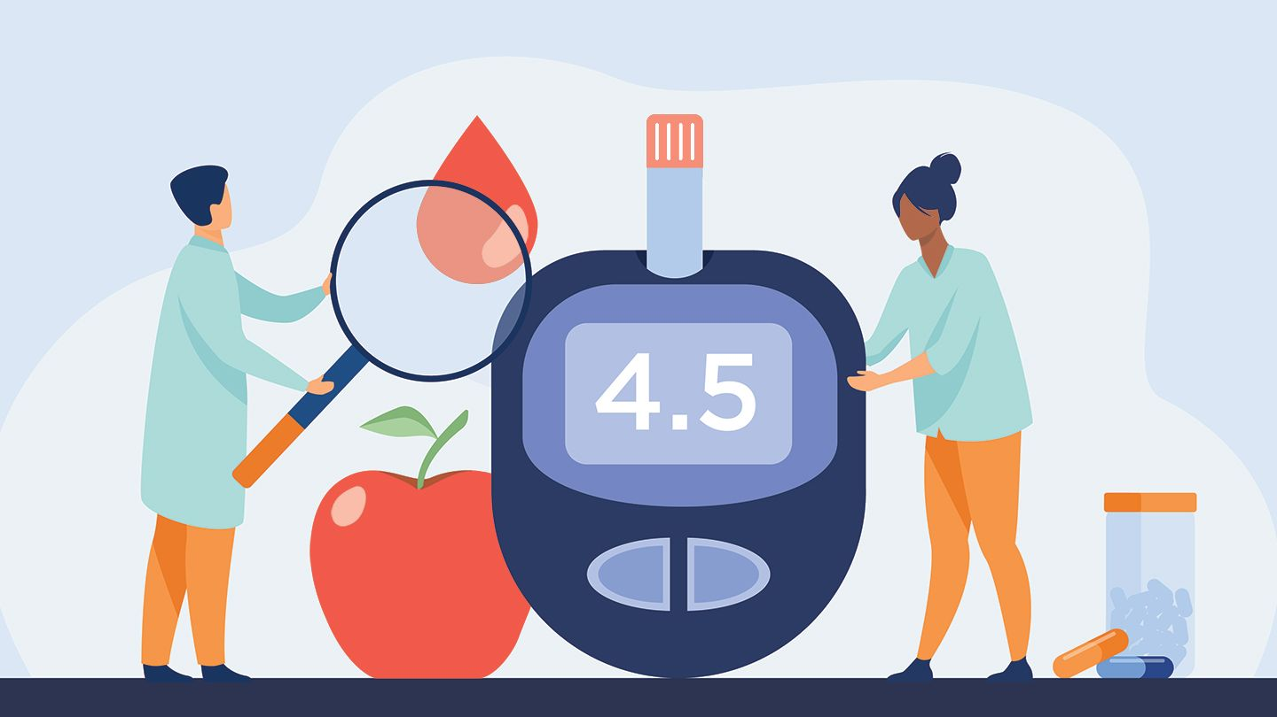
DBA5106 Group Project
Predictive Modeling to Identify Diabetic Patients
A0231956Y / Gino Martelli Tiu
A0231905L​ / Susan Koruthu
A0231857Y / Widya Gani Salim
A0231930N / Xhoni Shollaj
Notes:
Good afternoon everyone, thanks for joining us!
My name is Gino and today, we will be proposing a way to improve our claim process and inject a twist into our business model by leveraging on some predictive modeling

Slide 2

Meeting Agenda
Introduction
Problem Statement
Proposed Solution and Metrics
Data Analysis
Datasets Overview
Exploratory Data Analysis (EDA)
Model Selection
Model Performance
Results and Expected Benefits
Implementation
Business Implication and Implementation
Next Steps

Slide 3
The true costs of diabetes
7th Leading Cause of Death in the U.S
Annual Cost
7th
1 in 4
US$327 Billion
1 in 4 health care dollars spent in the U.S is on diabetes
Leading Cause of Death
Healthcare Dollar Expenditure
Who covers these costs?
We do.
Notes:
Diabetes is one of the leading causes of death with significant economic and productivity costs.
Insurance companies have their business model based on carefully assessing patients as diabetic or not.
They charge a recurring fee in exchange for covering a person’s future medical expenses
Therefore they have a vested interest in mitigating preventable diabetes (less claims would mean increased cash flow)
The right predictive model could potentially save the companies a huge proportion of the total costs currently incurred

Slide 4
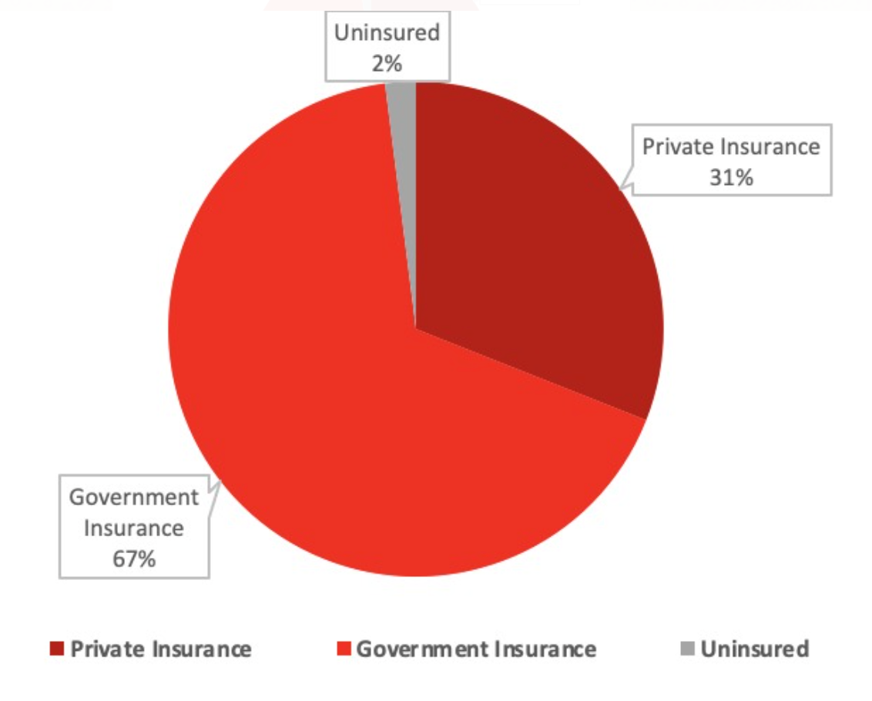
A costly problem
Distribution of Diabetes Treatment Claims Coverage
Annual cost (per individual)
Up to $18,652
Existing classification method detects only around 30% of diabetics cases.
Average premium charged $7,470
Annual loss (per individual)
$11,182
What can we do to manage this risk?
Notes:
I want all of the pie chart to show first >> click>>> then the annual cost stuff, >>> click >>> after that annual cost disappears >>>> click >>>> Existing classification method detects only around 30% of diabetics cases >>> click >> closing tagline what can we do to manage this risk

Slide 5
Our proposed solution
A classification model with 2 key objectives:
(1) Compute the probability of diabetes diagnosis given lifestyle & medical test variables
(2) Identify high risk individuals for monitoring and intervention
Medical and personal data are readily available to us, let’s take advantage.

Slide 6

Our proposed performance metric
Probability | Case | Cost | Remark
P(Predicted Diabetic | Diabetic) | True Positive | $16,572 | Base cost of diabetes treatment.
P(Predicted NonDiabetic│Diabetic) | False Negative | $18,652 | Base cost + cost associated with complications due to the lack of early treatment ($1,900).
P(Predicted NonDiabetic | NonDiabetic) | True Negative | $0 | No cost.
P(Predicted Diabetic | NonDiabetic) | False Positive | $200 | Cost for diabetes screening test.
Proposed metric measures cost saving as compared to current classification method.

Slide 7
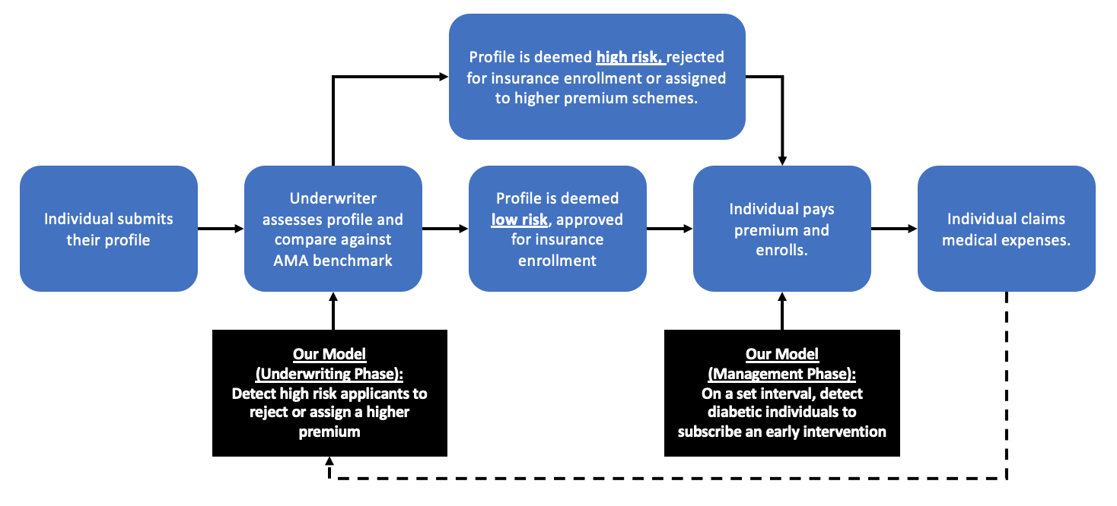
Integration with our operations
Trial run should focus on our existing customer first.

Slide 8




Our existing dataset
4
Tables
10,175
Observations
83
Original Features
Demographics
Gender
Age Group
Race
Education
Household income
...
Physical Exam
Body Mass Index
Blood pressure
Height
Weight
Grip strength
...
Blood Chemistry
Glycohemoglobin
Potassium
Lead
Cadmium
Insulin
...
Diabetic (y/n)
Notes:
Most of the visuals can be interpreted from your script here for most slide

Slide 9



Identifying key features
Notable Key Features Engineered & Relabeled:
High Risk
(based on AMA Guidelines)
BMI Group
Body Mass Index (BMI) ≥ 25
Age Group
Socioeconomic Status
Glycohemoglobin (%) ≥ 5.7
Marital Status
Oral Glucose Tolerance Test Level (mg/dL) ≥ 140**
High Risk
Notes:
We derived features that will allow us to derive insights (e.g: race, marital status) which were not considered by existing benchmark.
Most important is high risks.
But other alternative features include….

Slide 10
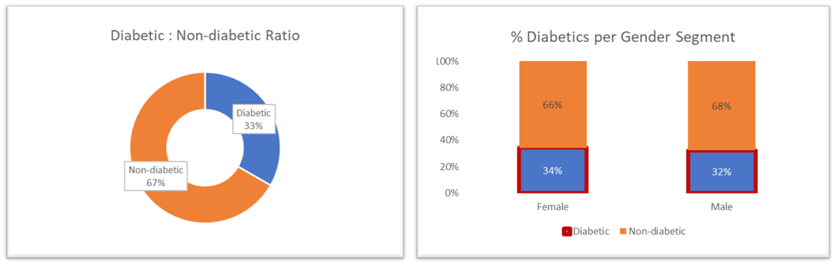
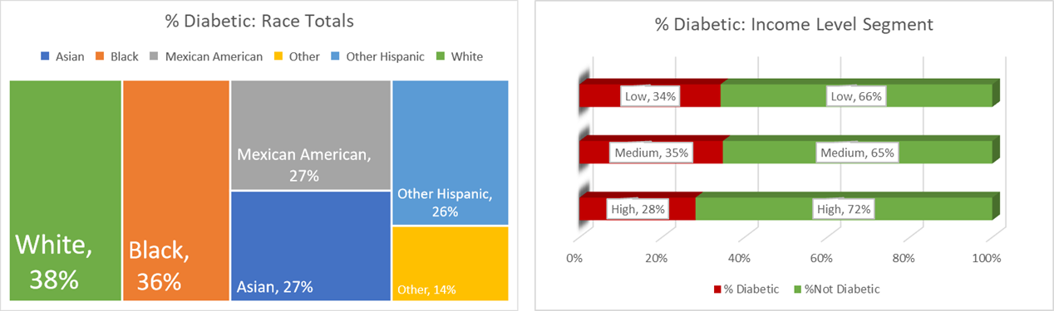
Exploratory data analysis
Focus is to find relevant features that could affect predisposition to diabetes.

Slide 11
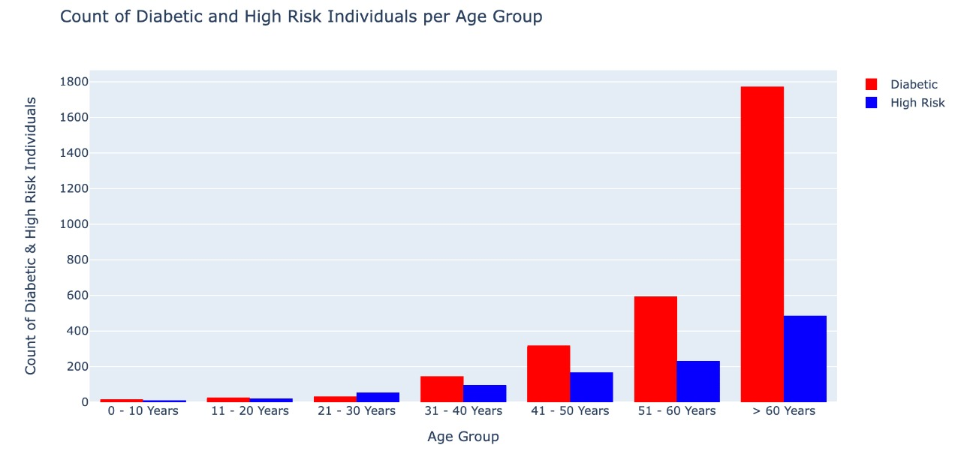
Exploratory data analysis
How can we use these insights to manage our risks?
Notes:
The number of positive cases and high risk increase as age increases.
This is notably a steep curve for confirmed diabetics from age 31-40 to the >60 cluster
A similar upward, albeit significantly muted trend is observed for high risk individuals for the same age range.

Slide 12
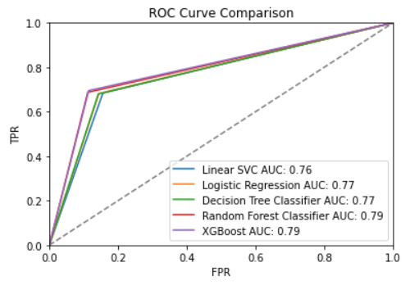
Selected model based on performance
5
Models Compared
XG Boost performed best
Notes:
Thank you Widya!
We ran and compared 5 different classification models: log reg, svc, dtc, random forest and xgboost.
AUC value is the area under the curve which compares the True Positive Rate (i.e: how many times positive cases are identified as positive) and FPR (how many times negative cases are identified as positive). This value is of importance as it allows us to measure the costs associated with false identification when training different models.
We found that XG Boost performed the best with an AUC value of 0.79. Although its AUC is equal to that of Random Forest, we found that XG Boost gives a better true positive rate which is of importance to our business case. We need to ensure that we identify diabetics accurately. Misidentifying diabetics will cost us an extra $1900 per person.

Slide 13
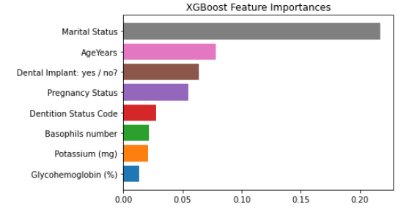
Interesting insights from top features
Extracted model features improve on the current detection capability and allow early intervention and better risk management.
Notes:
Model features from xgboost and the other algorithms provide potential indicators that boost chances of early detection and allow us to interevene early before the disease progresses. This is more important given that 90-95% cases are preventable/reversible. Not only does it provide positive optics for the company, it also mitigates expensive future claims that cut the company bottom line.

Slide 14
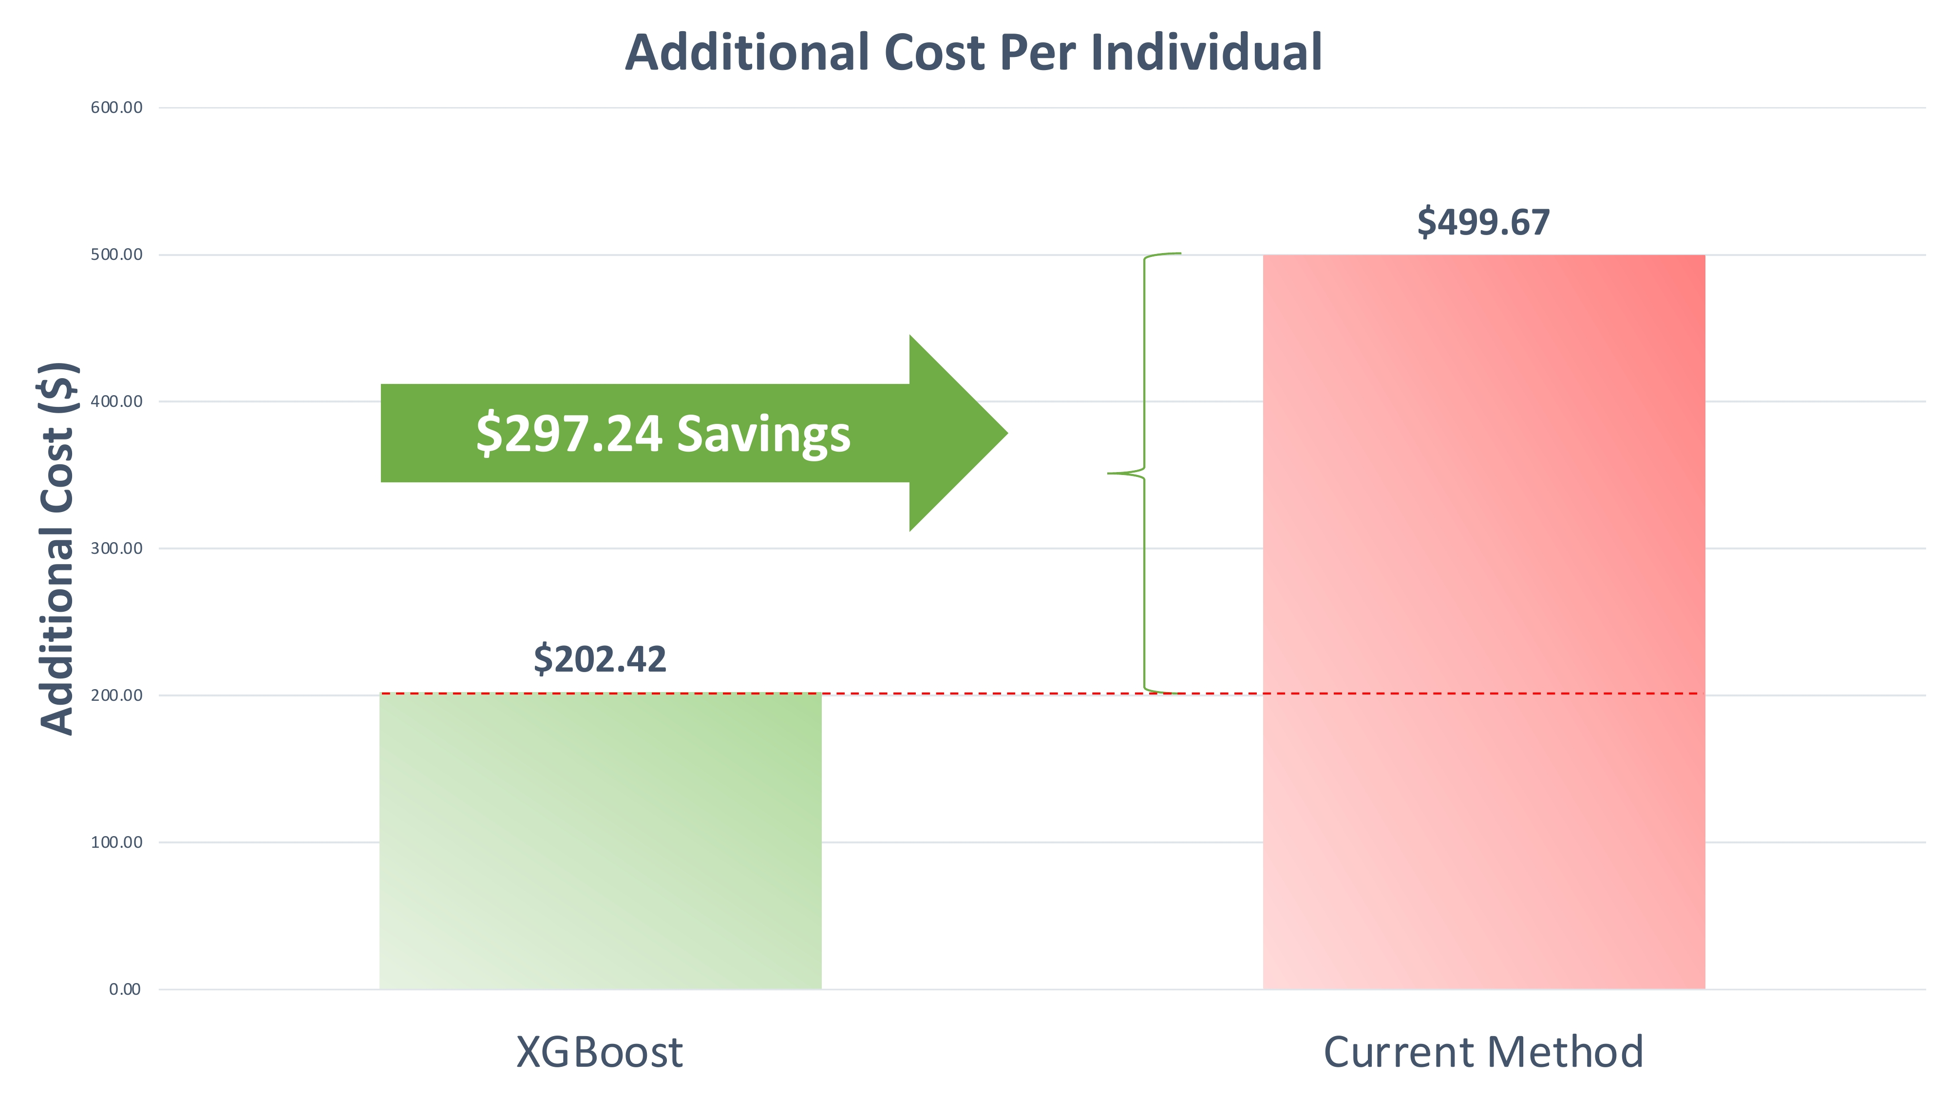
Our results and their expected benefit
Potential cost saving is 59.49% from early and improved detection vs current industry standard…
Notes:
Potential cost saving is 59.49% from early and improved detection vs current industry standard…
From an individual level, that’s roughly 300 USD per head
Superimpose this over 2900 individual and that translates to an uptick of 800k to the annual bottomline of the insurance company

Slide 15
Implementation & Next Steps
Three steps to up to 59.49% cost-saving:
Model deployment in management phase.
Incentive or penalty scheme for those detected as diabetic.
Track cost-savings as a performance metrics.
Notes:
Our model can be easily implemented as discussed in earlier parts, so we are only 3 steps away from 59.49% potential cost savings.
First, we have to deploy the model in management phase. Again, we expect minimal operations disruptions as we are doing trial runs with our existing customers and the model aligns perfectly with existing operating procedures.
Second, while we detect the patients for diabetes, we need to provide an incentive or penalty scheme, in order to enforce the prevention.
Lastly we need to be able to track and record through time the cost savings and be able to further improve the model.
In the given flowchart, we can discern the process given in simple steps:
First we have the individual profile submission, which is followed by an assessment conducted by an underwriter to compare against the set benchmark.
After the assessment, the abovementioned would be classified to low risk and high risk. The high risk profiles would either be rejected or assigned to a higher premium, while the low risk profiles would be approved for enrollment.
The final phase includes the individual paying and claiming the medical expenses.
And this is where our model kicks in – detecting diabetic individuals to subscribe early for intervention –and reusing and adjusting that in the underwriting phase, detecting high risk applicants, to design a higher premium or even reject the patient from enrollment.

Slide 16

Future Considerations
Phase 2
Phase 1 (Now)
Target Pre-Diabetic
Cases
Deployment to Management Phase
Deployment to Underwriting Phase
Compute Probability of Positive Diagnosis
Performance & Business Impact Reviews
Provide Medical Benchmarks
Identify High Risk Individuals
Connect Patients with Merchant Partners
The model is scalable and its cost-saving impact can be easily measured.
Notes:
Based on the implementation that we formulated, we compiled a set of future considerations to be taken into account for further scalability and cost saving.
In the first phase, we have classified the deployment phase, calculating the probability of positive diagnosis and finally identification of the high risk individuals. After all this is integrated through the performance and impact reviews we can undertake phase 2, which includes:
Targeting pre-diabetic cases, deploying to the underwriting phase for profile assessment and continuously readjust new medical benchmarks for profile evaluation after which we will connect the patients with merchant partners.

Slide 17
Thank You
We are in the business of managing risks.
Are we going to take an action to manage such an obvious risk?

Slide 18
Thank You

Slide 19
References:
Dataset: https://wwwn.cdc.gov/nchs/nhanes/
Model Libraries: https://scikit-learn.org/stable/user_guide.html
Facts on Diabetes(1): https://www.who.int/news-room/fact-sheets/detail/diabetes
Diabetes costs (2): https://www.diabetes.org/resources/statistics/cost-diabetes
CDCP Statistics (3): https://www.cdc.gov/diabetes/library/features/diabetes-stat-report.html
NUS MSBA 5106 Lectures
Appendix
DBA5106 Group Project: Predictive Modeling to Identify Diabetic Patients
Notes:
mkt value
other major players
currently us mkt
tittle

